Slide 1


Slide 2
Project analysis slide 3
TYPES OF OS
WINDOWS
MAC OS
LINUX
ANDROID
UBUNTU
It is existed in one form or other form it is the most used os for the home and office computers.
Apple os is one of the most popular os In the world it runs on apple hardware including iphones ,ipads etc
Now a days programmers from all over the world collaborate on its open source.it is mostly used in corporate and scientific servers.
Android is the most popular operating system in the world it is largely developed by google
Ubuntu is a free and open source linux distribution based on Debian .

Slide 3

Project analysis slide 7
ANDROID
Android is the most used mobile os in the world.
Android was founded in palo alto, California, in October 2003
Android was founded by andy rubin, rich miner, nick sears, chris white.
Android was developed by a consortium of developers known as the open hand alliance
.
“”There are 2.5 billion android users it is covering 40% among the 73% mobile users”
2,500,000

Slide 4

Project analysis slide 2
ADVANTAGES OF ANDROID
1
3
Low Investment
Easy To Integrate
2
Open Source
4
Easy Adoption

Slide 5
ADVANTAGES
Availability of Apps:-majority of the apps in Google Play are free as compared to the paid apps on iPhone.
Since Android OS is open source and it is part of the Open Handset Alliance, most of the leading handset manufacturers in the world have Android phones.
Integrated Applications & Features: - E.g. : Android allows an option to share, after taking a photo with the Camera.
Free to customizes: -You can customize widgets as you wish to.

Slide 6
Project analysis slide 10
GRAPH OF NO . OF ANDROID USERS
.
The bar graph shows the number of android users increasing year to year

Slide 7

Project analysis slide 11
TYPE OF APPLICATION :
HANDY LIBRARY
Handy library is a library management system application for android
We can keep track of books that you lend to or borrow from your friends and notify when a book is overdue.
This application supports 18 languages.
Organizing books by shelves or categories.

Slide 8
Description On ER-Diagram
ER-Diagram is known as entity relationship
There are many applications in library by using ER-Diagram
This is known as Attribute.It is a description of a single object or a person.
This is known as Entity. It is a real world object.It
can be place,object or person

Slide 9
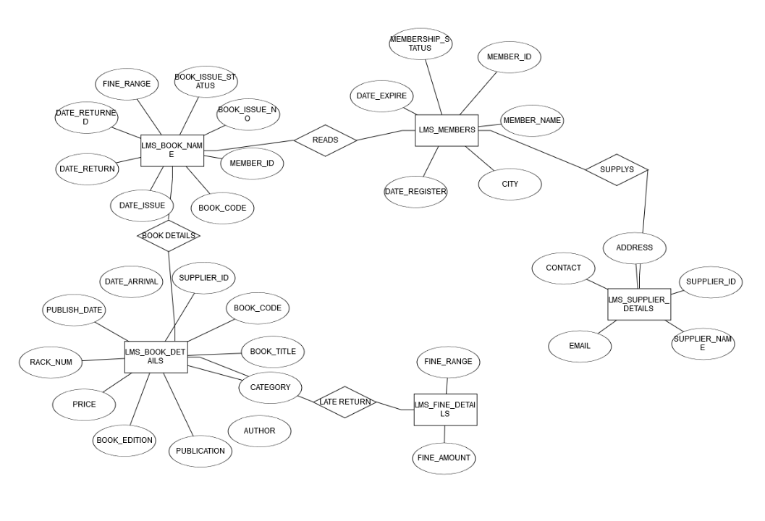
ENTITY RELATION DIAGRAM
Notes:
9

Slide 10
QUERIES ON THE ABOVE TABLE:
1.Write a query to display the memberid,membername and city who are having lifetime membership.Lifetime membership status is “Permanent”.
Ans: Select member_id,member_name,city from LMS_MEMBERS where
membership_status=‘Permanent’
2.Write a query to display a book code,booktitle and author of the books whose author name begins with ‘P’
Ans: Select book_code,book_title,author from LMS_BOOK DETAILS where author like ‘%P’.
3. Write a query to display the total number of Java books available in library with alias name ‘NO_OF_BOOKS’.
Ans: select COUNT(Java) as NO_OF_BOOKS from LMS_BOOK_DETAILS group by Java

Slide 11
Networking and topology
Topology defines the structure of the network of how all the components are interconnected to each other.
There are two types of topology:
Physical topology
Logical topology

Slide 12
Types of network topology
Mesh topology
Star topology
Bus topology
Ring topology

Slide 13
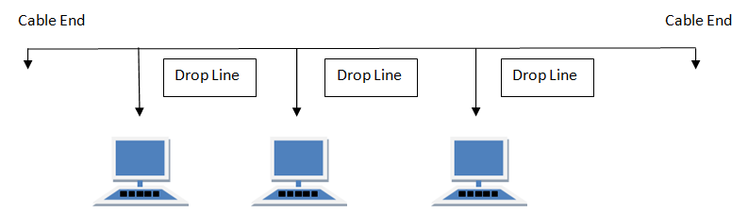
Bus topology
Bus topology is a network type in which every computer and network device is connected to single cable.
When it has exactly two endpoints, then it is called Linear Bus topology
Advantages of Bus Topology
It is cost effective.
Cable required is least compared to other network topology.
Used in small networks

Slide 14
Advantages of Bus Topology
Cost effectiveness
Least cable expenditure
Highly viable for small scale networks
Easy to set up and understand

Slide 15
WHY BUS TOPOLOGY ?
Among the four topologies we choosed the bus topology for our project for presenting the books management in the library because our plan is to execute the program which should collect the book details , renewal, return date etc…It would be easy as all the devices can be connected to this network in addition to computers. this can increase the speed of productivity because instead of sending commands to a central network , a command can be sent directly to the needed peripheral .and with bus topology the network allows data to flow freely through out the network so the output for the given input will come fast.

